Slide 1

JavaScript and jQuery Course
Session 04

Slide 2
Objects
Window Object - top level object
alert() method
prompt() method
confirm() method
parseInt() – global function
parseFloat() – global function
new

Slide 3
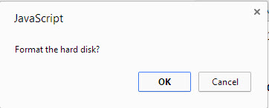
Window Object
confirm() method
var response = confirm('Format the hard disk?');
// user clicks OK
if(response) {
alert('You clicked okay!');
}
// user clicks Cancel
else {
alert('You clicked cancel!');
}

Slide 4
Window Object
parseInt() global function
var x = '10’;
X = parseInt(x); // returns a whole number 10
parseFloat() global function
var y = ‘0.5’;
y = parseFloat(y); // returns a decimal number .5

Slide 5
Window Object
parseInt() global function
var x = ‘10xxx’;
X = parseInt(x); // returns a whole number 10
var y = ‘xxx10’;
y = parseInt(y); // returns a NaN
var z = ‘xxx’;
z = parseInt(z); // returns a NaN
Not a number
Not a number

Slide 6
Document Object
Document Object - top level object in DOM
write() method
writeLn() method – adds a new line character in the source code
document.getElementById(id) method

Slide 7
Objects
Document Object Model
allows access to any HTML element by making an object reference using the value of the ‘id’ attribute
document.getElementById(id) method

Slide 8
Textbox Object
<label for="fname">First name</label>
<input type="text" id="fname" name="fname">

Slide 9
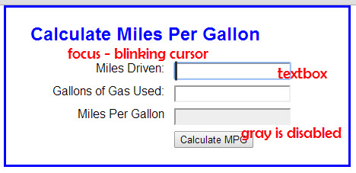
Textbox Object
Method – focus()
Property – value
Property - disabled

Slide 10
Textbox Object - retrieve the value
<label for="fname">First name</label>
<input type="text" id="fname" name="fname">
var firstName = document.getElementById("fname");
firstName = firstName.value;
alert(firstName); // displays Teresa

Slide 11
Textbox Object - retrieve the value (Chaining)
<label for="fname">First name</label>
<input type="text" id="fname" name="fname">
var firstName = document.getElementById("fname").value;
alert(firstName); // displays Teresa

Slide 12
Textbox - always returns a string value
To Convert to an integer or float (for calculations)
parseInt() parseFloat()
<label for="riceCost">Rice cost:</label>
<input type="text" id="riceCost" name="riceCost">
var riceCost = document.getElementById("riceCost").value;
// value of riceCost is "12.34" (text)
var iRiceCost = parseInt(riceCost); // value is 12
var fRiceCost = parseFloat(riceCost); // value is 12.34

Slide 13
Textbox - always returns a string value
<label for="riceCost">Rice cost:</label>
<input type="text" id="riceCost" name="riceCost">
var riceCost = document.getElementById("riceCost").value;
// value of riceCost is "12" (text)
var iRiceCost = parseInt(riceCost); // value is 12
var fRiceCost = parseFloat(riceCost); // value is 12

Slide 14
Textbox - always returns a string value
<label for="riceCost">Rice cost:</label>
<input type="text" id="riceCost" name="riceCost">
var riceCost = document.getElementById("riceCost").value;
// value of riceCost is "12 34" (text)
var iRiceCost = parseInt(riceCost); // value is 12
var fRiceCost = parseFloat(riceCost); // value is 12

Slide 15
Textbox - always returns a string value
<label for="riceCost">Rice cost:</label>
<input type="text" id="riceCost" name="riceCost">
var riceCost = document.getElementById("riceCost").value;
// value of riceCost is "$12.34" (text)
var iRiceCost = parseInt(riceCost); // value is NaN
var fRiceCost = parseFloat(riceCost); // value is NaN

Slide 16

isNaN() – JS global function
<label for="riceCost">Rice cost:</label>
<input type="text" id="riceCost" name="riceCost">
var riceCost = document.getElementById("riceCost").value;
// value of riceCost is "$12.34" (text)
var iRiceCost = parseInt(riceCost); // value is NaN
var fRiceCost = parseFloat(riceCost); // value is NaN
Test that it is a valid number before parsing
if(isNaN(riceCost){
// returns true or false
}

Slide 17
isNaN() – JS global function
isNaN(123) //false
isNaN(-1.23) //false
isNaN(5-2) //false
isNaN(0) //false
isNaN('123') //false
isNaN('Hello') //true
isNaN('2005/12/12') //true
isNaN('') //false
isNaN(true) //false
isNaN(undefined) //true
isNaN('NaN') //true
isNaN(NaN) //true
isNaN(0 / 0) //true

Slide 18
Empty textbox
empty
A textbox without any user entered value returns “”
It is empty – it is not null
To validate that the user entered a value
if(txtVariableValue == “”){
// returns true or false
}

Slide 19
Undefined vs empty vs null in JavaScript
undefined
A variable without a value, has the value undefined.
The typeof is also undefined.
The typeof operator returns type information as a literal.
There are six possible values that typeof returns:
"number“
"string“
"boolean“
"object“
"function“
"undefined“
empty
An empty string variable has both a value and a type.

Slide 20
Undefined vs empty vs null in JavaScript
null
In JavaScript null is "nothing". It is supposed to be something that doesn't exist.
Unfortunately, in JavaScript, the data type of null is an object.
You can consider it a bug in JavaScript that typeof null is an object. It should be null. this is a bug which may be fixed at some point.
Therefore: do not use null when comparing variable values!

Slide 21
Validate textbox contains a number
empty
A textbox without any user entered value returns “”
It is empty – it is not null
To validate that the user entered a value
if(txtVariableValue == “”){
// returns true or false
}

Slide 22
Validate textbox contains a number
NaN
A textbox with an invalid number returns “NaN”
isNaN() – global function
- will return true if not a valid number
To validate that the user entered a value
if(isNaN(txtVariableValue)){
// returns true or false
}

Slide 23
Date Object
JS Object
Date() – uppercase “D”
Returns: day, number, month, year, hour, minutes, seconds, milliseconds
to retrieve, set, perform calculations – EBAY / Bb

Slide 24
Date Object
Begins January 1, 1970 at midnight
epoch or Unix epoch
86,400,000 milliseconds in one day

Slide 25
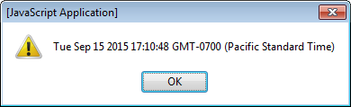
Date() Object – create it
var today = new Date();
alert(today);
instance of object
JS object
JS keyword / operator

Slide 26
Date() Object – create it
var today = new Date();
Holds number of milliseconds
since January 1, 1970 at midnight

Slide 27
Methods of Date() Object
var today = new Date();
today.getDate() | Returns the day number of the month (1 - 31) var monthDay = today.getDate();
today.getDay() | Returns an integer for the day of the week Sunday = 0, Monday = 1, ... Saturday = 6 var dayOfWeek = today.getDay();
today.getMonth() | Returns an integer for the month January = 0, ... December = 11 var month = today.getMonth();
today.getFullYear() | Returns the year as 4 digits var fullYear = today.getFullYear();
today.getYear() | Returns the year as 2 digits var year = today.getYear();

Slide 28
Methods of Date() Object
var today = new Date();
today.getTime() | Returns milliseconds since midnight 1/1/1970 var time = today.getTime();
today.getHours() | Returns the current hour, 0 to 23, universal time var currentHour = today.getHours();
today.getMinutes() | Returns the current minute, 0 to 59 var currentMinute = today.getMinutes();
today.getSeconds() | Returns the current second, 0 to 59 var currentSecond = today.getSeconds();
today.getMilliseconds() | Returns the current millisecond, 0 to 999 var currentMilliseconds = today.getMilliseconds();

Slide 29
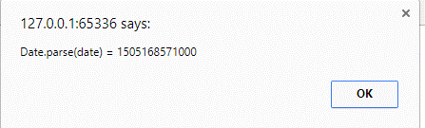
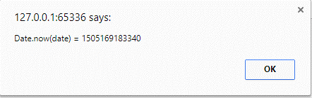
Methods of Date() Object
var today = new Date(); // using Sept 11, 2017
Date.parse() | Returns: milliseconds since 1/1/1970 Local time var milsec = Date.parse(today);
Date.now() | Returns: milliseconds since 1/1/1970 UTC var milsec2 = Date.now(today);
today.toDateString() | Returns: Mon Sep 11 2017 var str1 = today.toDateString();

Slide 30
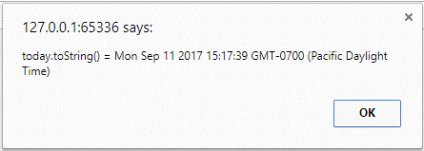
Methods of Date() Object
var today = new Date(); // using Sept 11, 2017
today.toLocaleDateString() | Returns: 9/11/2017 var str2 = toLocaleDateString();
today.toLocalString() | Returns: 9/11/2017, 3:17:39 PM var str3 = today.toLocalString();
Today.toString() | var str4 = today.toString();

Slide 31
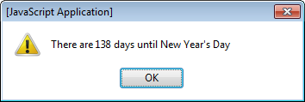
Date calculations
// create new date for next New Year's day
var nextYear = new Date().getFullYear() + 1;
var daysNewYear = new Date(nextYear, 0, 1); // next Jan 1
// get today's date
var today = new Date();
// calculation
var days = Math.round((daysNewYear - today) / 86400000);
alert("There are " + days + " days until New Year's day");

Slide 32
String Object
Object is automatically created when you assign a string value to a variable
var name = “Teresa”;
Property
length - name.length; // 6

Slide 33
String Object
var name = “Teresa”;
Methods
toUpperCase(), toLowerCase() - name.toUpperCase; // TERESA
indexOf() - name.indexOf(“T”); // 0
substr() - name.substr(0, 3); // Ter
substring() - name.substring(0, 6); // Teresa
Character in the string
Starting point, number characters
Begin, end

Slide 34
Function
Block of code
that we can reuse
Makes writing code cleaner
Executes when you call it
Called when an event occurs
Page load
Click

Slide 35
Function – stored in a variable
var sayHello = function() {
alert("Hello");
}
sayHello();
Stored in a variable
Function Call
usually called from inside another function
or when page loads

Slide 36
Function - named
_{function sayHello() {} _{alert("Hello");}
}
_{sayHello();}
Uses the
function keyword
How the function
is called
- usually from another function

Slide 37
Function – called from an event
_{window.onload = function() {}
_{sayHello();}
}
What we have used
Executes when the event happens

Slide 38
Function – stored in external file
_{function sayHello() {} _{alert("Hello");}
}
Stored in file.js
_{<head>}
<script src=“file.js”></script>
_{<script>}
_{window.onload = function() {}
_{sayHello();}
}
_{</script>}
_{</head>}

